Slide 1
Making Networks Work
Chapter 5

Slide 2
Learning Objectives
Understand and explain OSI reference model
Understand and explain IEEE 802 networking model and related standards
Explain OSI reference model’s layers and their relationship to networking hardware and software

Slide 3
OSI and 802 Networking Models
Models create intellectual framework to clarify network concepts and activities
Open Systems Interconnection (OSI) reference model is most successful model
Proposed by International Organization for Standardization (ISO)
IEEE 802 networking model is an influential set of networking standards
Encompasses most network types and is open-ended, allowing additions for new types

Slide 4
Role of a Reference Model
Networking is built on common framework
Model clarifies process by breaking down features and functionality into layers
Easier to comprehend
Helps with component compatibility

Slide 5
OSI Reference Model
Provides useful way to describe and think about networking
Breaks networking down into series of related tasks
Each aspect is conceptualized as a layer
Each task can be handled separately

Slide 6
Understanding Layers
Layering helps clarify process of networking
Groups related tasks and requirements
OSI model provides theoretical frame of reference
Clarifies what networks are
Explains how they work

Slide 7
OSI Reference Model Structure
Breaks networked communications into seven layers, as seen in Figure 5-1:
Application
Presentation
Session
Transport
Network
Data Link
Physical

Slide 8
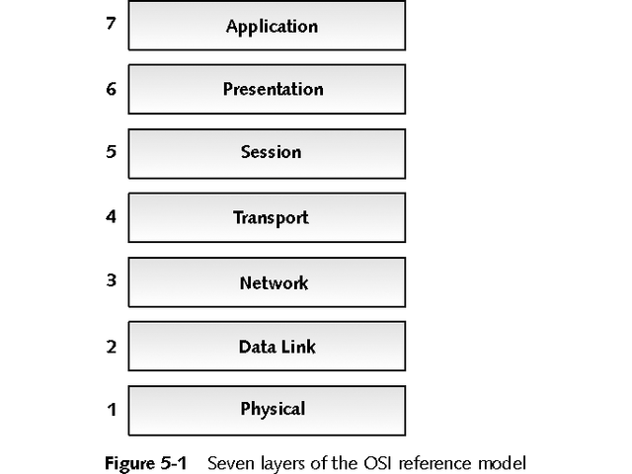
Seven Layers of OSI Reference Model

Slide 9
OSI Reference Model Structure
A computer must have a protocol stack to access a network
Most common network protocol stacks include:
Transmission Control Protocol/Internet Protocol (TCP/IP)
Internetwork Packet Exchange/Sequenced Packet Exchange (IPX/SPX)
NetBIOS Enhanced User Interface (NetBEUI)
AppleTalk
Systems Network Architecture (SNA)

Slide 10
OSI Reference Model Structure
Protocols plus drivers equal network access
Each layer of OSI model communicates and interacts with layers immediately above and below it
Each layer responsible for different aspect of data exchange
Each layer puts electronic envelope around data as it sends it down layers or removes it as it travels up layers for delivery

Slide 11
OSI Reference Model Structure
Interface boundaries separate layers
Individual layer communicates only adjacent layers
“Peer layers” describes logical or virtual communication between same layer on both sending and receiving computers
See Figure 5-2

Slide 12
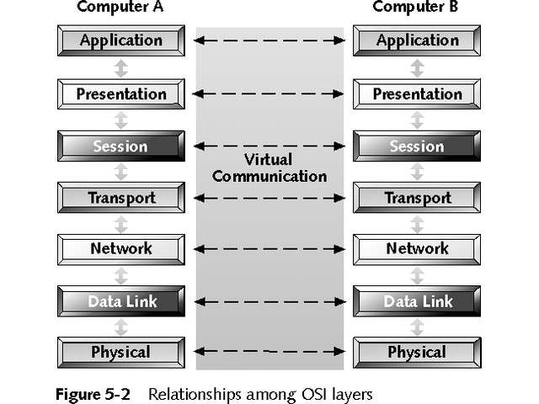
Relationships Among OSI Layers

Slide 13
OSI Reference Model Structure
Date is broken into packets or PDUs as it moves down stack
PDU stands for protocol data unit, packet data unit, or payload data unit
PDU is self-contained data structure from one layer to another
At sending end, each layer adds special formatting or addressing to PDU
At receiving end, each layer reads packet and strips off information added by corresponding layer at sending end

Slide 14
Application Layer
Layer 7 is top layer of OSI reference model
Provides general network access
Includes set of interfaces for applications to access variety of networked services such as:
File transfer
E-mail message handling
Database query processing
May also include error recovery

Slide 15
Presentation Layer
Layer 6 handles data formatting and protocol conversion
Converts outgoing data to generic networked format
Does data encryption and decryption
Handles character set issues and graphics commands
May include data compression
Includes redirector software that redirects service requests across network

Slide 16
Session Layer
Layer 5 opens and closes sessions
Performs data and message exchanges
Monitors session identification and security
Performs name lookup and user login and logout
Provides synchronization services on both ends
Determines which side transmits data, when, and for how long
Transmits keep-alive messages to keep connection open during periods of inactivity

Slide 17
Transport Layer
Layer 4 conveys data from sender to receiver
Breaks long data payloads into chunks called segments
Includes error checks
Re-sequences chunks into original data on receipt
Handles flow control

Slide 18
Network Layer
Layer 3 addresses messages for delivery
Translates logical network address into physical MAC address
Decides how to route transmissions
Handles packet switching, data routing, and congestion control
Through fragmentation or segmentation, breaks data segments from Layer 4 into smaller data packets
Reassembles data packets on receiving end

Slide 19
Data Link Layer
Layer 2 creates data frames to send to Layer 1
On receiving side, takes raw data from Layer 1 and packages into data frames
Data frame is basic unit for network traffic on the wire
See Figure 5-3 for contents of typical data frame
Performs Cyclic Redundancy Check (CRC) to verify data integrity
Detects errors and discards frames containing errors

Slide 20
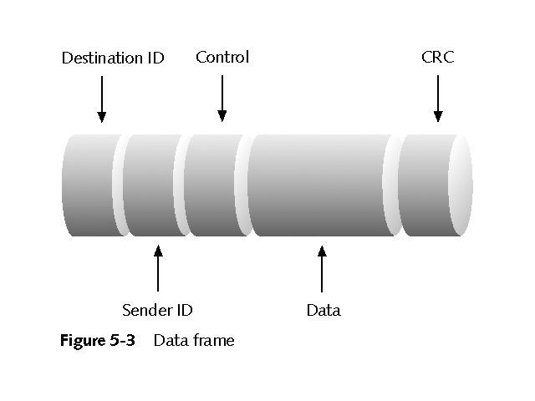
Data Frame

Slide 21
Physical Layer
Layer 1 converts bits into signals for outgoing messages and signals into bits for incoming messages
Manages computer’s interface to medium
Instructs driver software and network interface to send data across medium
Sets timing and interpretation of signals across medium
Translates and screens incoming data for delivery to receiving computer

Slide 22
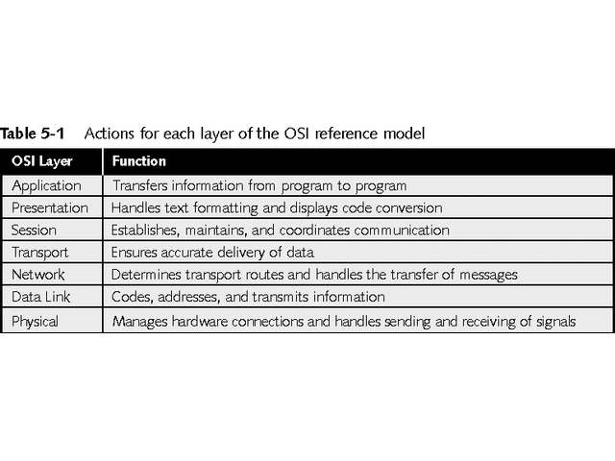
Actions of Each layer of OSI Reference Model

Slide 23
IEEE 802 Networking Specifications
Institute of Electrical and Electronic Engineers (IEEE) started Project 802 to define LAN standards
Set standards to ensure compatibility among network interfaces and cabling from different manufacturers
Concentrates on physical elements of network like NICs, cables, connectors, and signaling technologies
Concentrates on lower two levels of OSI model: Physical and Data Link layers

Slide 24
IEEE 802 Specifications
Project 802 includes many standards, numbered 802.1 through 802.18
See Table 5-2
For more information about 802 standards, see http://www.ieee.org/

Slide 25
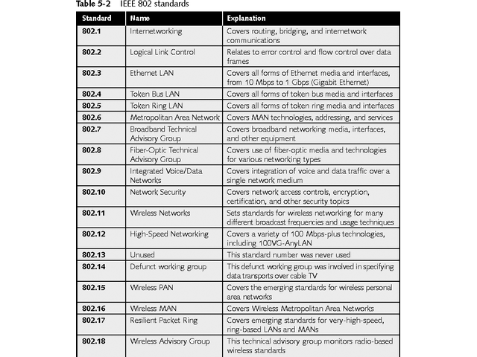
IEEE 802 Standards

Slide 26
IEEE 802 Extensions to the OSI Reference Model
IEEE specification expanded OSI reference model at Physical and Data Link layers
Breaks Data Link layer into two sublayers
Logical Link Control (LLC) for error recovery and flow control
Media Access Control (MAC) for access control
See Figure 5-4

Slide 27
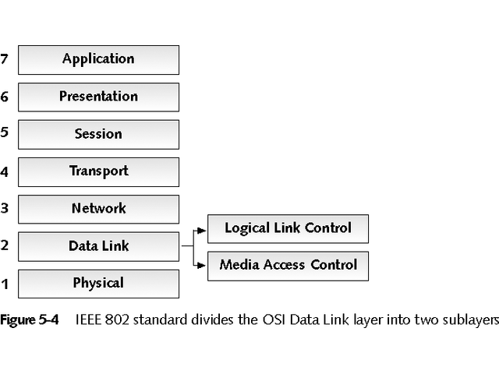
IEEE 802 Standard with two Sublayers of OSI Data Link Layer

Slide 28
IEEE 802 Extensions
IEEE 802.2 defines two Data Link sublayers
Logical Link Control (LLC) sublayer
Defines logical interface points, called Service Access Points (SAPs) that transfer information from the LLC sublayer to upper OSI layers; includes error detection and recovery
Media Access Control (MAC) sublayer
Communicates with NIC to read physical address from PROM; responsible for error-free data transmission
See Figure 5-5 for IEEE specifications map

Slide 29
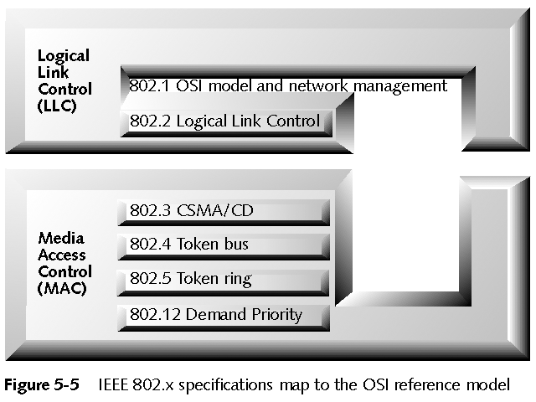
IEEE 802.x Specification Map to OSI Reference Model

Slide 30
Chapter Summary
OSI reference model and IEEE Project 802 define frame of reference for networking and specify lower-layer behaviors for most of today’s networks
These models describe complex processes and operations involved in sending and receiving information across a network
OSI reference model breaks networking across seven layers, each with its own purposes and related activities

Slide 31
Chapter Summary
From bottom up, the seven layers of the OSI reference model are: Physical, Data Link, Network, Transport, Session, Presentation, and Application.
Most network products and technologies are positioned in terms of the layers they occupy
Layers help describe features and functions that products and technologies deliver

Slide 32
Chapter Summary
IEEE 802 project elaborates on functions of Physical and Data Link layers
Data Link Layer is broken into two sublayers: Logical Link Control (LLC) and Media Access Control (MAC)
Together, these sublayers handle media access, addressing, control (through MAC sublayer) and provide reliable error-free delivery of data frames from one computer to another (through the LLC sublayer)

